Slide 1
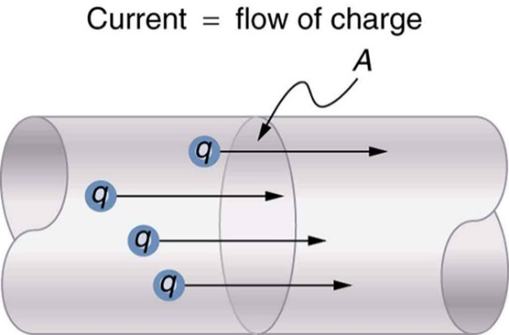

Is your work well presented?
Energy Transferred
Lesson Objectives
1. Define what is meant by work.
2. Calculate the energy transferred by an electrical appliance using the equations E = P t.

Slide 2

Work
Achieving Objective 1
1. Define what is meant by work.
Keywords: Electrons, Energy, Force, Potential, Transferred, Work.
When an object is moved by a f______, e_______ is transferred and w____ is done. But work is not a form of energy - it is one of the ways in which energy can be t________.
Explain how work done occurs in a circuit when a potential difference is applied?
The p_______ difference causes e_______ to flow. This is an energy transfer. W____ is done.
Review
What have we found out?
Is your work well presented?

Slide 3
Work
Achieving Objective 1
1. Define what is meant by work.
When an object is moved by a force, energy is transferred and work is done. But work is not a form of energy - it is one of the ways in which energy can be transferred.
Explain how work done occurs in a circuit when a potential difference is applied?
The potential difference causes electrons to flow. This is an energy transfer. Work is done.
Review
What have we found out?
Is your work well presented?

Slide 4
Achieving Objective 2
2. Calculate the energy transferred by an electrical appliance using the equations E = P t.
Energy transferred
The amount of energy transferred by electrical work can be calculated using the equations:
Energy transferred (E) = Power (P) × time (t)
Example: What is the energy transferred to a resistor when the power is 5W over 25 seconds.
energy = 5W × 25s
energy = 125 J
Review
What have we found out?
Is your work well presented?

Slide 5
Achieving Objective 2
2. Calculate the energy transferred by an electrical appliance using the equations E = P t.
Energy transferred
Can you re-arrange (change the subject) of these equations?
Energy transferred (E) = Power (P) × time (t)
Power (P) = ?
Time (t) = ?
Energy transferred (E) ÷ Time (t)
Energy transferred (E) ÷ Power (t)
Review
What have we found out?
Is your work well presented?

Slide 6
Achieving Objective 2
2. Calculate the energy transferred by an electrical appliance using the equations E = P t.
Energy transferred
What is the energy transferred when the power is 0.5kW over 5 minutes?
What is the energy transferred when the power is 3W over 0.5hours?
How long is a 3W washing machine run for to use 210J?
What is the power of an appliance when 550.0J is used over 20s?
How many minutes does a 5.5kW boiler run for to use 660kJ?
energy = 150000J (150kJ)
energy = 5400J
time = 70s
power = 27.5W
Time = 2 minutes
Review
What have we found out?
Is your work well presented?

Slide 7
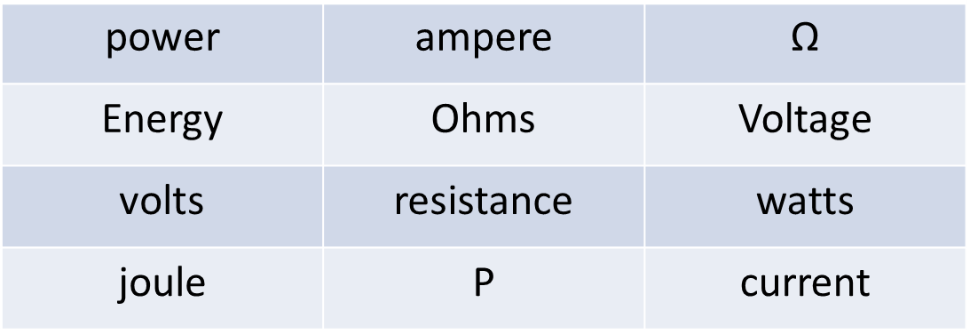
Plenary
Describe how these factors are interrelated by giving equations or describing the links in sentences?
Lesson Objectives
1. Define what is meant by work and charge flow.
2. Calculate the energy transferred by an electrical appliance using the equations E = P t and E = Q V
3. As LO2, to include a change in subject.
Review
What have we found out?
Is your work well presented?

